Slide 1
Multi-dimensional Modeling of Interactions between Nutrients and Riparian Vegetation for Improved Riverine Ecosystem Management
PDT Lead: Todd Steissberg
Product Development Team: Billy Johnson, Zhonglong Zhang, Alex Sanchez, Mark Jensen, Chuck Theiling
Corps District Collaboration: Brian Zettle (CoP Lead), Chris Solek (Los Angeles District), Craig Evans (St. Paul District), Jeff Tripe (Kansas District)

Slide 2
Multi-dimensional Modeling of Interactions between Nutrients and Riparian Vegetation for Improved Riverine Ecosystem Management
PDT Lead: Todd Steissberg (ERDC)
Product Development Team:
Billy Johnson (LimnoTech)
Zhonglong Zhang (PSU)
Alex Sanchez (HEC)
Mark Jensen (HEC)
Chuck Theiling (ERDC)
Corps District Collaboration:
Brian Zettle (Mobile District, CoP Lead)
Jeff Tripe (Kansas City District)
Chris Solek (Los Angeles District)

Slide 3
Project Purpose - Recap
SON: 2015-ER-1 - Multi-dimensional Modeling of Interactions between Nutrients and Riparian Vegetation for Improved Riverine Ecosystem Management
Need:
The Corps needs a science-based, defensible tool to quantify ecosystem benefits to the aquatic environment and to riparian buffers that result from ecosystem restoration projects.
Purpose:
Improve Vegetation Mapping - Riparian vegetation can be better represented by 2D meshes than by simple 1D cross-sections.
Improve Vegetation Modeling - Integrating water quality and riparian vegetation modeling into the multi-dimensional hydrodynamic model (HEC-RAS-2D) will be better able to model nutrients and riparian vegetation, and their interactions in both aquatic systems and floodplains.
Notes:
Keep it simple and clear. You may use a second slide if needed, however.

Slide 4
Benefits
Improves decision-making capabilities and reduces operations and maintenance costs
HEC-RAS models provide detailed river hydraulics data and maps (flow, velocity, and water levels). Integrating water quality capabilities leverages these capabilities and existing models to provide detailed hydraulics, water quality and riparian vegetation information for rivers.
HEC-RAS is already widely deployed for ecosystem restoration projects – as a hydraulic model. Additional vegetation and water quality capabilities provide critical short-term and long-term information about dynamic river systems. This helps in designing restoration projects that are stable and functional, while also reducing operations and maintenance costs.
Leverages existing models and expertise, reducing costs
HEC-RAS is widely deployed (100,000 downloads per year), with calibrated hydraulic models already applied to almost all rivers and streams in the U.S., thus reducing the cost of building WQ/vegetation models by at least 50%.
Notes:
Keep it simple and clear. You may use a second slide if needed, however.

Slide 5
Approach
HEC-RAS 1D water quality and vegetation (RVSM) development tasks have been completed, including a Jupyter notebook UI for RVSM.
These provide essential capabilities needed for current and future USACE studies.
Develop 2D WQ as a separate program that will:
Leverage existing and future HEC-RAS hydraulics models
Allow independent development, distribution, and maintenance by EL staff
The new approach will:
Adapt and extend the 2D WQ transport module (“solver”) developed in FY19
Improve and utilize EL’s CLEARWATER modules (TSM, NSM, etc.)
Components:
2D WQ transport module
CLEARWATER modules
Python computational framework
Jupyter notebook interface

Slide 6
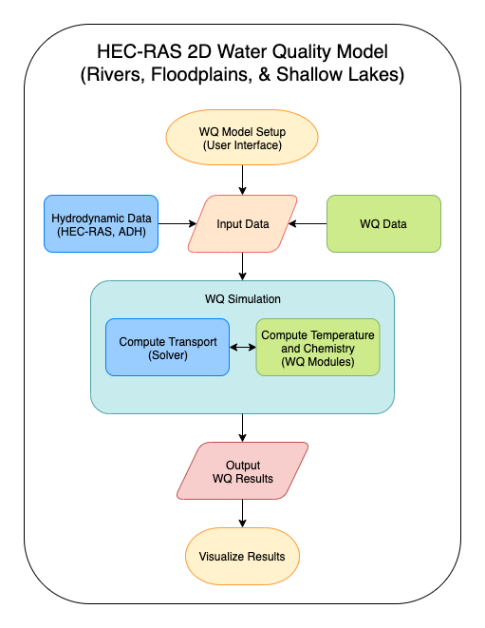
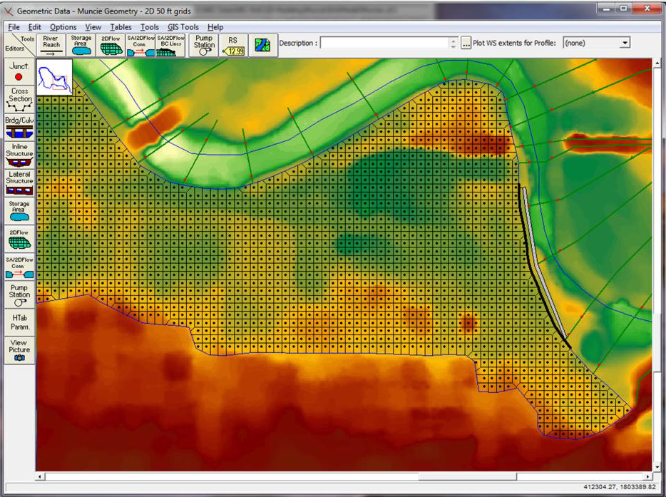
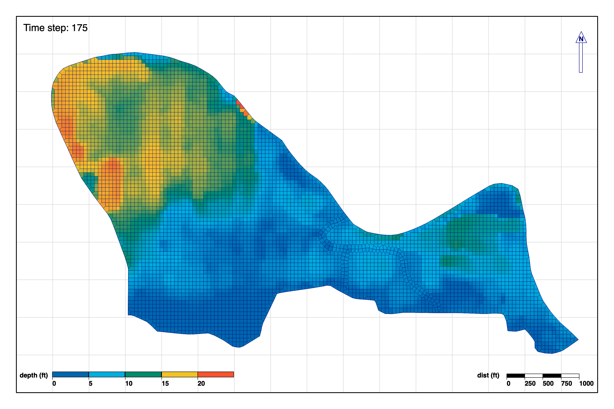
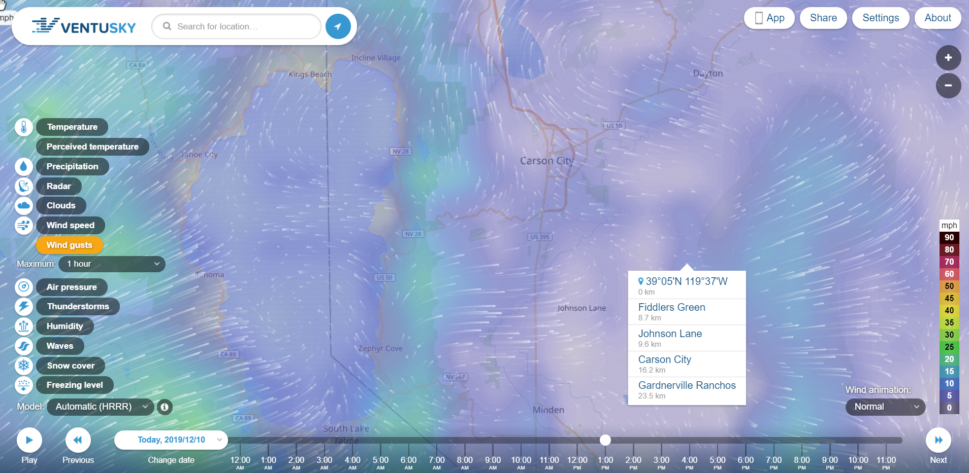
Approach 2D Water Quality
Notes:
Include all PRODUCTS/DELIVERABLES as specified in the original WU documentation

Slide 7
Field Engagement
Project Planning
Team meetings & conference calls
Periodic project updates to PDT, ERARG members, and field personnel by phone, web meeting, and email
Reporting
Provided quarterly updates to the USACE Water Quality Committee
Field Coordination
Presented water quality capabilities to EPA
Collaborating with USGS Colorado Water Science Center to link WEBMOD (Water, Energy, and Biogeochemical Model) with ClearWater-Riverine to input runoff water quality into 2D water quality simulations

Slide 8
Scheduled Products RAS 2D WQ Tasks, FY20-22
Scheduled Products
Task | Description | Scheduled Due Date (Qtr/Year) | Percent Complete (%)
1. | WQ Modules: Upgrade WQ modules & documentation (temperature, general constituents, nutrients) | Q2/FY21 | 100
2. | User Interface and Visualization: Build vegetation and WQ user interface (UI) tools | Q1/FY21 | 100
3. | Transport Engine: Finalize 2D transport solver (advection-diffusion) & framework | Q4/FY21 | 100
4. | Integration: Link 2D transport solver, WQ modules, and UI | Q4/FY21 | 100
5. | Testing and validation | Q2/FY22 | 25
6. | Technical Transfer: Documentation (TR and TN) and project demo | Q4/FY22 | 15
7. | Technical Transfer: Workshop | Q4/FY22 | 0
Notes:
Include all PRODUCTS/DELIVERABLES as specified in the original WU documentation

Slide 9
Additional Products/Achievements
Additional Products/Achievements
Description | (Qtr/Yr)
Recruited computer scientist at EL-EPW in FY21 Abstracts on HEC-RAS-1D-WQ, HEC-RAS-RVSM, and NSM presented at National Conference for Ecosystem Restoration (NCER), July 2021 Collaborating with USGS Colorado Water Science Center to link WEBMOD (Water, Energy, and Biogeochemical Model) with ClearWater-Riverine to input runoff water quality into 2D water quality simulations | Q3/FY21 Q4/FY21 Q1 – Q4/FY21

Slide 10
FY 21 Accomplishment 1 Task 1: Water Quality Modules
New streamlined water quality modules developed in Python that compute a single cell
Temperature Simulation Module (TSM)
Code development completed
API documentation completed
General Constituent Simulation Module (GSM)
Code development completed
API documentation completed
Nutrient Simulation Module (NSM)
Code development completed
API documentation completed
Notes:
Describe product and capability, importance/impact, etc.. Describe product and capability. Employ images generously. Tell a good story.

Slide 11
FY 21 Accomplishment 2 Task 2: User Interface and Visualization Tools
Developed Jupyter notebooks for software testing, training, and deployment
Developed new plotting capabilities:
Meteorology time series plots
Water quality time series plots
2D plots plots and animations
Handles all known coordinate systems with an EPSG code or WKT definition file
Easy reprojection of coordinate system
Displays background maps
Notes:
Describe product and capability, importance/impact, etc.. Describe product and capability. Employ images generously. Tell a good story.

Slide 12
FY 21 Accomplishment 3 Task 3: Transport Engine and Framework
The ClearWater-Riverine water quality modeling tool consists of a transport engine, simulation framework, and other components to simulate water quality given hydraulic and geometry data input from an HEC-RAS-2D model
Transport engine:
Water quality transport solver completed (Fortran version)
Simplified 2D water quality transport engine developed in Python
Simulation framework: controls the simulation, time step, input/output, etc.
Water quality modules
New streamlined water quality modules developed in Python that compute a single cell that link with the Python transport engine
Notes:
Describe product and capability, importance/impact, etc.. Describe product and capability. Employ images generously. Tell a good story.

Slide 13
FY 21 Accomplishment 3 Task 3: Transport Engine and Framework
ClearWater-Riverine WQ modeling tool, continued:
“Stations”
Meteorology and water quality inputs
Water quality outputs
Easily input time series from Excel, CSV, and HDF5
Temporal interpolation supports any model time step and irregular input time series data
Can create constant-value time series for any variable
Plot function allows the generation of period of record time series for each variable that has been added to the station
Meteorology Stations – additional features
Supports standard meteorological measurements and data, such as wind coefficients
Correct for wind sensor height
Can estimate atmospheric pressure from station elevation and air temperature
Can estimate solar radiation from station geolocation and cloudiness
Notes:
Describe product and capability, importance/impact, etc.. Describe product and capability. Employ images generously. Tell a good story.

Slide 14
FY 21 Accomplishment 3 Task 3: Transport Engine and Framework
ClearWater-Riverine WQ modeling tool, continued:
Water quality stations (“Station” + additional features)
Supports input of WQ time series
Allows input of observed data and other time series data to drive or calibrate & validate the model
Output stations (“Station” + additional features)
Supports water quality and hydraulic outputs
2D time series are output to HDF5
Time series output supported for specified grid cells or regions
Allows specifying a radius. A time series of the average of all cells falling within that radius of the station will be output to either CSV or HDF5
Notes:
Describe product and capability, importance/impact, etc.. Describe product and capability. Employ images generously. Tell a good story.

Slide 15
FY 21 Accomplishment 4 Task 4: Integration
The ClearWater-Riverine modeling tool links together all components: transport engine, modules, etc.
The simulation is partially controlled by the specified output time step of the HEC-RAS model.
An output time step of five minutes is recommended.
Time steps longer than 15 minutes should be used with caution, since the water quality and transport changes can be large enough to destabilize the solutions.
Notes:
Describe product and capability, importance/impact, etc.. Describe product and capability. Employ images generously. Tell a good story.

Slide 16
FY 21 Accomplishment 5 Task 6: Technical Transfer
The National Conference on Ecosystem Restoration (NCER), Virtual, July 2021
Organized two sessions on water quality modeling software and applications
The development team and collaborators presented six abstracts on NSM, HEC-RAS-1D-WQ, HEC-RAS-RVSM, and applications of these models
F. Behzadi, A. Wasti, T. Steissberg, and P. Ray (accepted). Vulnerability assessment of drinking water supply under climate uncertainty using a river contamination risk (RANK) model. Journal of Environmental Modelling and Software.
Notes:
Describe product and capability, importance/impact, etc.. Describe product and capability. Employ images generously. Tell a good story.

Slide 17
Synopsis
Funding
FY20 $250K
FY21 $360K
FY22 $365K
Project $975K
Project Status
Completed alpha version of “ClearWater-Riverine” modeling tool that simulates water quality using models generated by HEC-RAS-2D
Project Focus
Under revised scope, RAS 2D WQ was developed as a separate product, “ClearWater-Riverine”
Jupyter notebook interface
Leverages HEC-RAS models and capabilities independent of the HEC-RAS development cycle
Reads geometry and hydraulic outputs from HEC-RAS-2D
Alpha version complete: framework, transport engine, plotting functions, user interface
Notes:
Funding for all FY’s funded

Slide 18
Summary
Alpha version of ClearWater-Riverine WQ modeling tool completed
Prototype water quality transport engines (Fortran and Python versions) with API documentation
Water quality modules: Python versions of TSM, GSM, and NSM
Stations (Meteorology, Water Quality, and Output) handle all time series and gridded data inputs and outputs
Stations handle interpolating time series data to the current model time step
2D time series plotting and animation tool developed
Handles all known projections with an EPSG code or WKT definition file
Time series plots supported for any cell or the average of a region consisting of multiple cells
The simulation framework ties everything together, coordinating model input, output, simulation time step, etc.
Technical transfer: NCER conference

